Slide 1


Sentinel: Intelligent Cyber Threat Defender

Slide 2

CONTENTS
01
Opening
02
Project Overview
03
System Architecture
04
Data Flow
05
ML Detection
06
Dashboards

Slide 3
CONTENTS
07
Phishing Module
08
Insights
09
Tech Stack
10
Challenges
11
Closing

Slide 4

01
Opening

Slide 5
AI-Powered Cybersecurity & Threat Intelligence System
Real-Time Risk Scoring, Threat Detection & Automated Insights
This presentation introduces an AI-powered cybersecurity system that offers real-time risk scoring, threat detection, and automated insights. It leverages advanced technology to provide comprehensive protection against cyber threats.

Slide 6
02
Project Overview

Slide 7
End-to-End AI Pipeline Overview
Real-Time Ingestion and Analysis
End-to-End AI Pipeline
Phishing Detection Module
Real-time data ingestion, machine learning anomaly detection, and large language model analysis are combined with interactive dashboards to provide actionable insights.
The project features an end-to-end AI pipeline designed to detect cyber threats in real-time. It integrates multiple components for seamless threat detection and analysis.
A specialized module for email, URL, and SMS phishing detection is included, enhancing the system's ability to identify and mitigate phishing threats.

Slide 8
03
System Architecture

Slide 9
High-Level System Architecture
Data Ingestion Layer
Spark Processing Engine
ML Anomaly Detection
Threat Classifier
A threat classifier
using TF-IDF and Logistic Regression analyzes Gmail, URL, and SMS data to identify and score potential threats.
The data ingestion layer uses Kafka-style simulation for streaming data, ensuring continuous and real-time data flow into the system.
Spark processes the incoming data, cleaning,normalizing,
and transforming logs to prepare them for analysis.
Machine learning models detect anomalies and generate risk scores,
providing a quantitative measure of potential threats.

Slide 10
04
Data Flow

Slide 11

Data Ingestion & Processing Pipeline
Simulated Streaming
Spark Data Processing
Simulated streaming using Python and Kafka-style events ensures a steady flow of data into the system for continuous monitoring.
Spark cleans, normalizes, and transforms the data, maintaining module independence for efficient
and scalable processing.

Slide 12
Intelligence Layer: ML, RL & LLM Engine
The system integrates a multi-layer intelligence engine combining machine learning, reinforcement learning and large language models. Unsupervised anomaly detection is performed using Isolation Forest, while Random Forest Classifier identifies malicious vs. normal events based on aggregated Spark features from network logs, login activity and user behavior.
A custom Gym cyber-environment then uses a PPO-based RL agent (with Q-learning fallback) to recommend mitigation actions such as blocking IPs, quarantining devices, throttling traffic or alerting administrators. This combined approach produces risk scores, policy-guided actions and incident classifications used across the SOC workflow.

Slide 13
05
ML Detection

Slide 14
ML Anomaly Detection Engine
01
Isolation Forest for Anomaly Detection
The Isolation Forest algorithm is used for anomaly detection, identifying unusual patterns in the data.
Risk Score Generation
Risk scores are generated by combining anomaly severity with classifier predictions, scaled to a 0–100 range for easy interpretation.
02

Slide 15
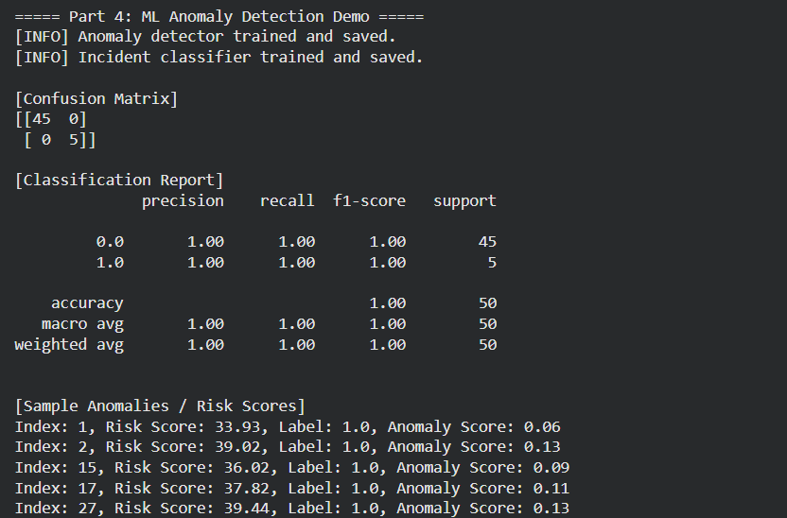
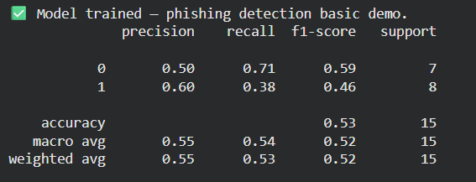
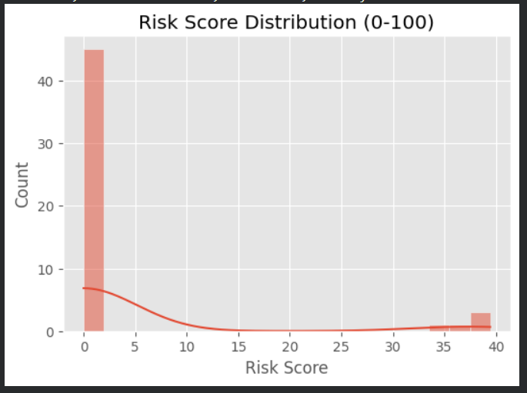
ML Anomaly Detection Engine
01
02

Slide 16
06
Dashboards

Slide 17
Risk Score & Mitigation Dashboard
Risk Score Trend
The Risk Score Trend chart helps analysts monitor the severity of incidents over time, providing a visual representation of threat levels.
Mitigation Cost Trend
Dashboard Insights
The Mitigation Cost Trend chart tracks the financial impact of incidents, aiding in cost-effective threat management.
These trends provide actionable insights for analysts to prioritize and address threats based on severity and financial impact.

Slide 18
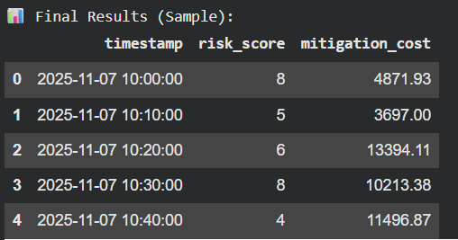
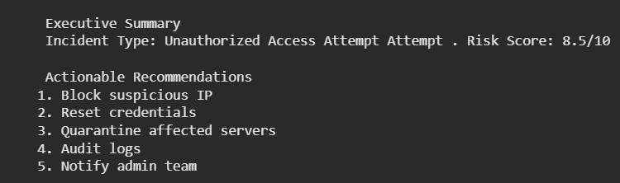
Mitigation cost & actions
Mitigation Cost Trend
Executive Summary

Slide 19
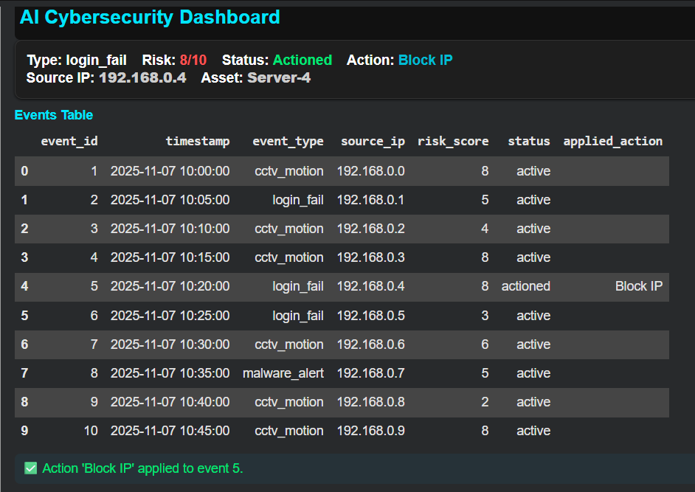
Dashboard Insights

Slide 20
07
Phishing Module

Slide 21
Gmail URL SMS Threat Detection
Simulated Email Inbox
Action Determination
A simulated inbox of 50 emails is processed using TF-IDF vectorizer and Logistic Regression to detect phishing threats.
The combined score determines the action: Quarantine, Review, or Safe, ensuring appropriate handling of potential threats.
URL and Attachment Analysis
Risk Distribution
URLs are extracted, and attachments are scored for risk, combining metrics to determine the overall threat level.
The module generates risk distribution and sender vs risk plots, providing detailed insights into threat sources.

Slide 22
08
Insights

Slide 23
Key Security Insights Uncovered
The system provides key insights, including average risk levels, mitigation costs, phishing email percentages, and identification of risky senders and subjects.
The system exports final results as structured CSV files, risk and cost trend plots, and an automatically generated PDF summary stored. These outputs compile end-to-end analytics from ingestion, detection, RL actions and business impact scoring.
The module also includes deployment mapping for GCP, covering Pub/Sub, Big Query, Vertex AI and Cloud Run, enabling seamless migration to a production environment.

Slide 24
09
Tech Stack

Slide 25
Technology Stack Overview
Optional Technologies
Core Technologies
Dashboard Tools
Optional technologies
like YOLO and
Stable-Baselines3
are considered for
future enhancements, expanding the system's capabilities.
The technology stack includes Python, Spark, Kafka-style simulation, Scikit-learn models,
TF-IDF, Pandas,
NumPy, Matplotlib,
and Plotly.
Streamlit and Dash
are used for creating interactive dashboards, providing real-time visualizations and
insights.

Slide 26
10
Challenges

Slide 27
Deployment Challenges & Fixes
Ubuntu Repo Errors
Java Gateway Stability
Ubuntu repo 404 errors were resolved by rewriting the sources.list file, ensuring smooth package installation.
Java 11 was manually installed to stabilize the Spark gateway, ensuring reliable data processing and analysis.

Slide 28
11
Closing

Slide 29
Conclusion & Next Steps
Complete Cybersecurity Framework
The system delivers a complete real-time AI cybersecurity framework, integrating ML, NLP, analytics, and automated threat scoring.
Modular and Scalable Design
Future Extensibility
The modular and scalable design ensures the system can be easily extended and adapted for enterprise use.
With its robust foundation, the system is poised for future enhancements, ensuring continuous protection against evolving cyber threats.

Slide 30

YOUR LOGO
THANK YOU

